Slide 1
Welcome to Your Young Eagles Flight!
YoungEagles.org
Sponsored by: EAA Chapter ####
City, St
EAA Chapter #### Young Eagles

Slide 2
About the Young Eagles Program
Launched in 1992 by EAA, the Experimental Aircraft Association, based in Oshkosh Wisconsin.
Our mission is to provide a meaningful flight experience – free of charge – in a general aviation aircraft for young people ages of 8 and 17.
More than 2.3 million Young Eagles have flown under the auspices of the program.
More than 50,000 EAA member volunteer pilots.
More than 40,000 ground support volunteers.
Young Eagle flights have been conducted in every state in America; each province in Canada; and in more than 90 other countries.
The flights have been safely conducted in nearly every type of general aviation aircraft, from light planes to business jets, and everything in between!
EAA Chapter #### Young Eagles

Slide 3
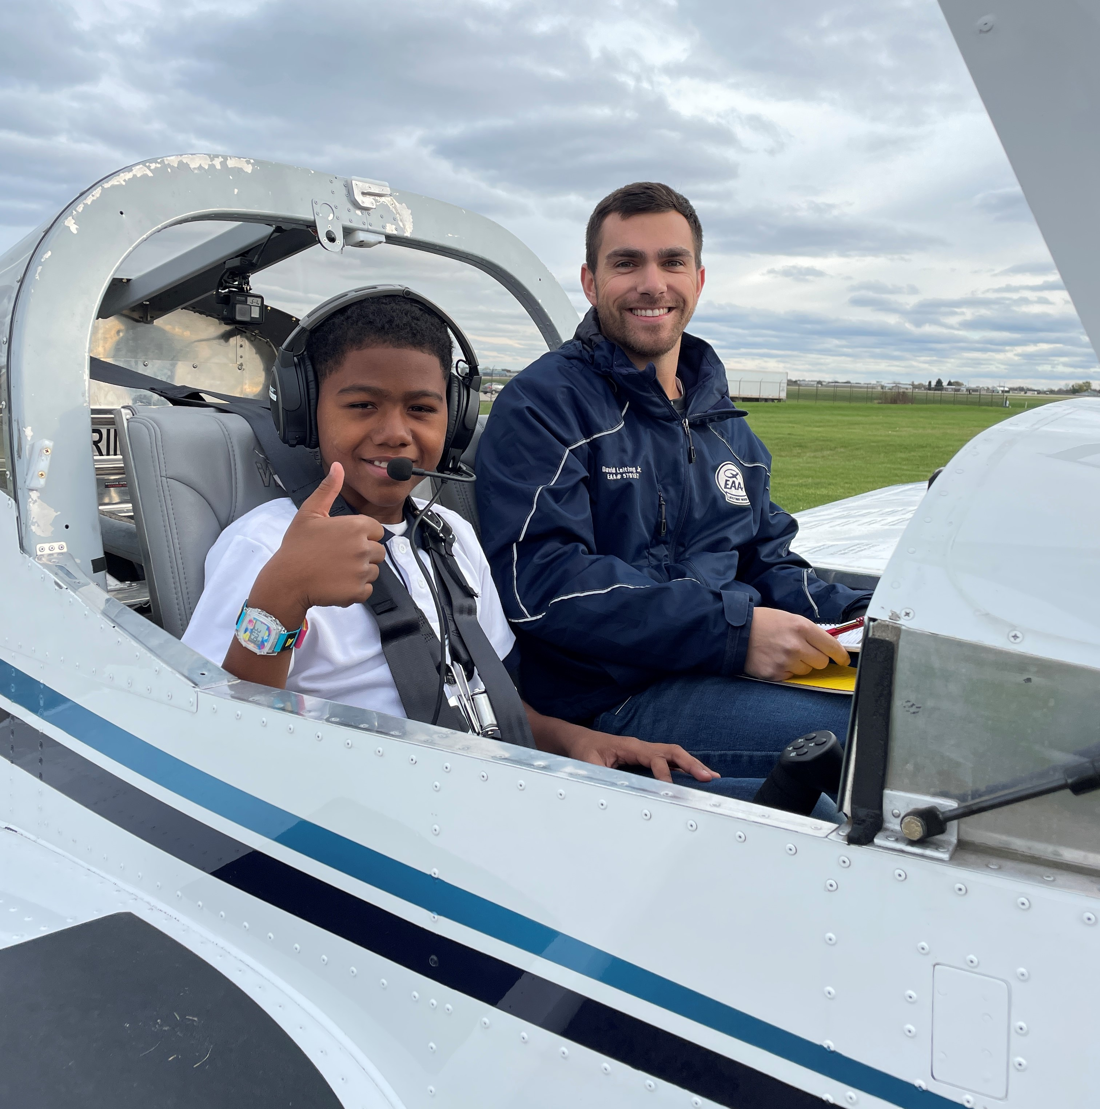
Young Eagles Pilots
The pilots are local members of EAA, who are volunteering their time and aircraft to make your child’s flight possible.
Each pilot is licensed by the Federal Aviation Administration (FAA) and all aircraft are likewise certified by the FAA.
The flights will be conducted according to federal regulations. No aerobatic maneuvers will be performed.
Each pilot is vetted via EAA’s Youth Protection Training and Background Check program.
EAA Chapter #### Young Eagles

Slide 4
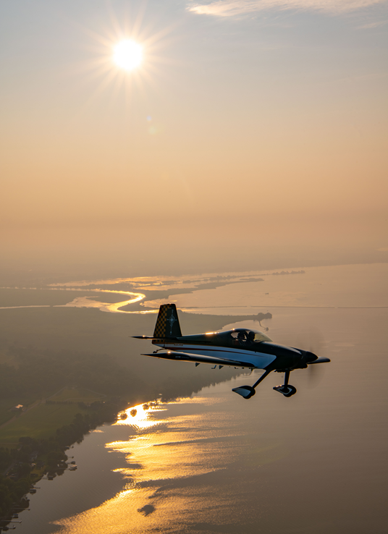
What will the flight be like?
The pilot complete a "walk around" preflight inspection of the airplane and identify the parts that control the airplane.
The pilot instruct your child on how to enter the aircraft and buckle their child's seat belt. The pilot may assist with these tasks.
Once in the air, your child will see the world below in a new and exciting way. They will experience the wonderful freedom of flight that many people only dream about.
The flight will last about 15 – 20 minutes, depending on a number of factors.
Following the flight, there will be additional time for photos and Q&A
Please listen to all pilot instructions (what not to touch, when to be quiet, etc.)
EAA Chapter #### Young Eagles

Slide 5
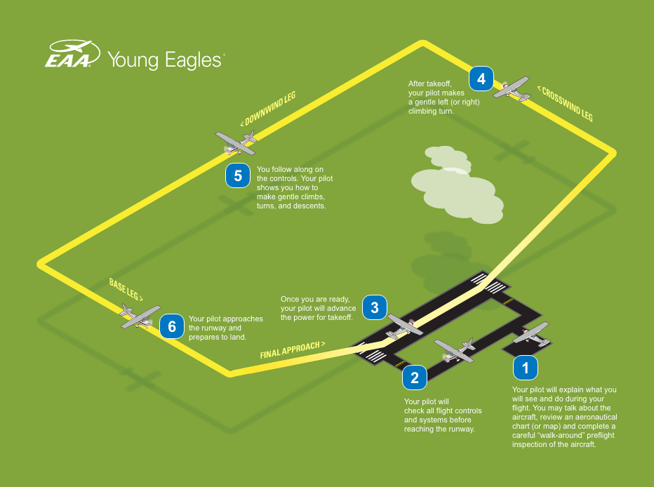

Slide 6
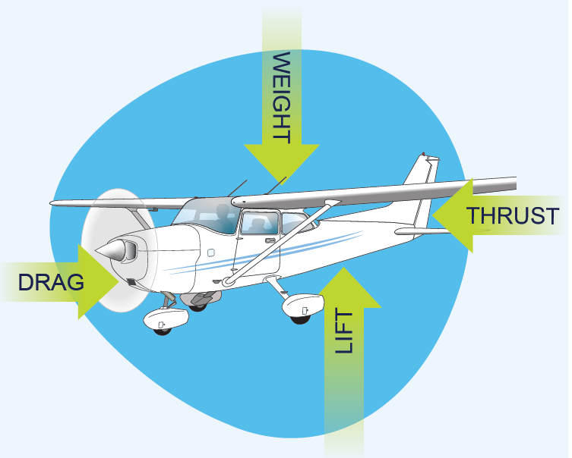
Four Forces of Flight What makes an airplane fly?
EAA Chapter #### Young Eagles
Notes:
Thrust - is a force that moves an aircraft in the direction of the motion. It is created with a propeller, jet engine, or rocket. Air is pulled in and then pushed out in an opposite direction. One example is a household fan.
Drag - is the force that acts opposite to the direction of motion. It tends to slow an object. Drag is caused by friction and differences in air pressure. An example is putting your hand out of a moving car window and feeling it pull back.
Weight - is the force caused by gravity.
Lift - is the force that holds an airplane in the air. The wings create most of the lift used by airplanes.

Slide 7
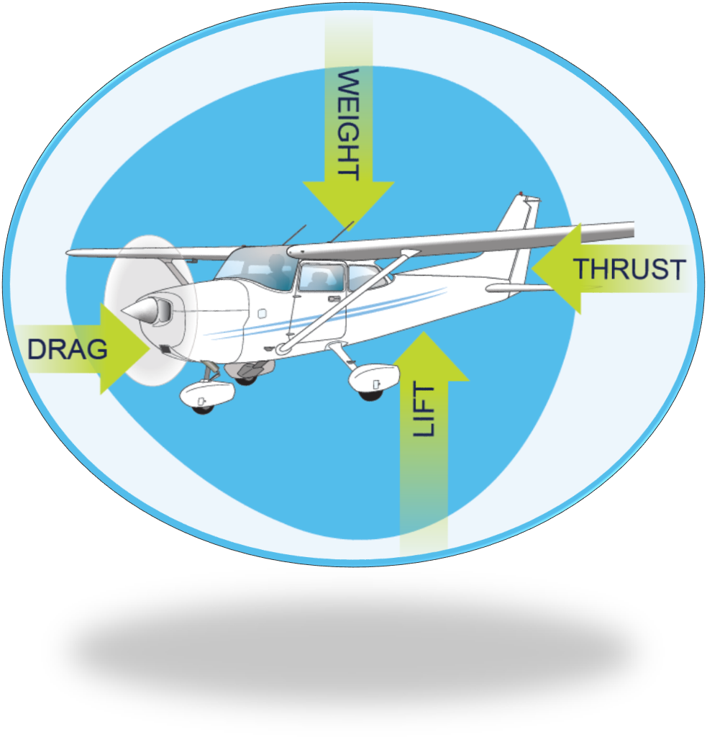
Four Forces of Flight What makes an airplane fly?
Thrust - is a force that moves an aircraft. It is created with a propeller, jet engine, or rocket. Air is pulled in and then pushed out in an opposite direction.
Drag - is the force that acts opposite to the direction of motion. It tends to slow an object. Drag is caused by friction and differences in air pressure. An example is putting your hand out of a moving car window and feeling it pull back.
Weight - is the force caused by gravity.
Lift - is the force that holds an airplane in the air. The wings create most of the lift used by airplanes.
EAA Chapter #### Young Eagles

Slide 8
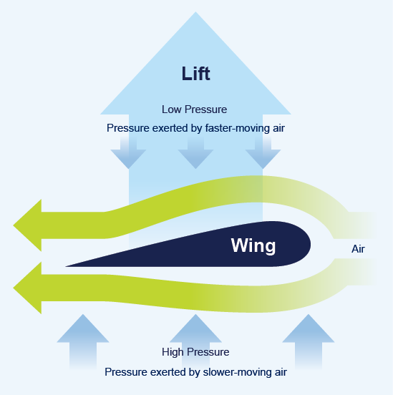
How is lift produced?
Newton’s Explanation – For every action there is an equal, and opposite reaction (Newton's Third Law)
Bernoulli’s Principle - This principle uses the fact that the top surface of a wing is more curved than the bottom surface.
High Pressure moves Low Pressure – Lift is created!
EAA Chapter #### Young Eagles

Slide 9
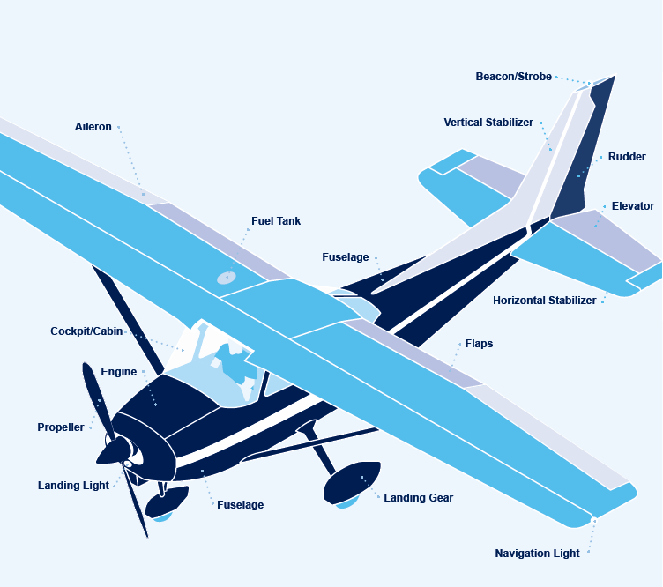
Parts of an Airplane

Slide 10
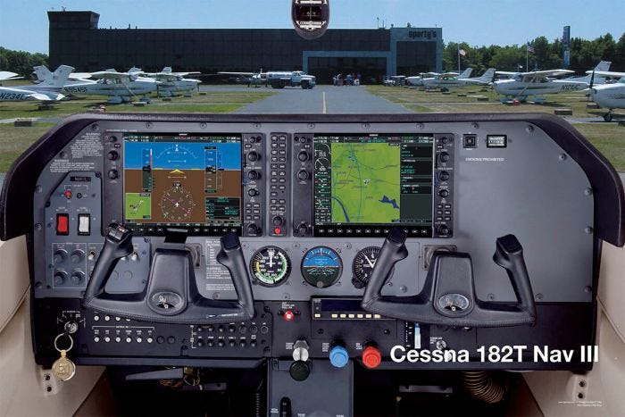
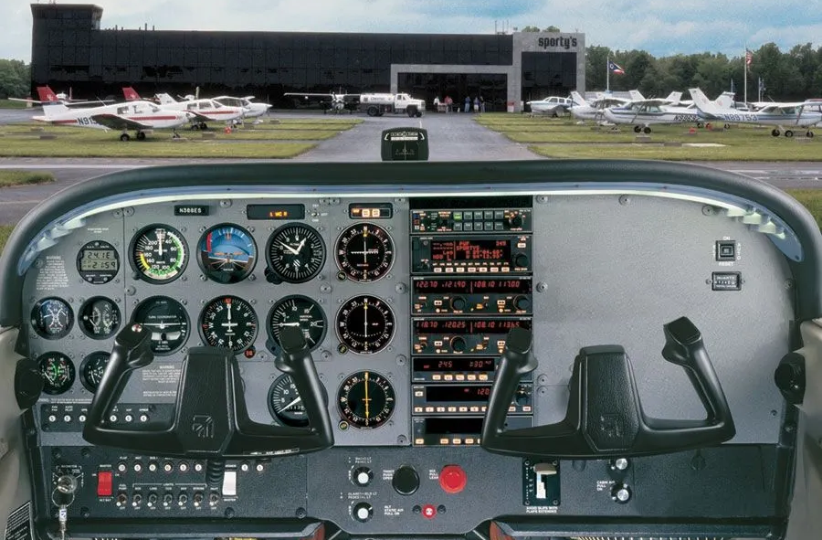
Instrument Panels
Glass cockpit
Steam gauge cockpit
EAA Chapter #### Young Eagles

Slide 11
Starting Flight Training
You can begin your training to become a private pilot, recreational pilot or sport pilot.
The FAA requires that you are 16 years old to solo a powered aircraft, and 14 years old for gliders.
The FAA requires that you are 17 years old to obtain your powered aircraft pilots certificate, and 16 years old for gliders.
Cost – This is hard to put a dollar figure on. It depends on many factors such as cost of the airplane, instructor time and pace of learning.
Locally, the average cost for a private pilot certificate is $#,###
EAA Chapter #### Young Eagles

Slide 12
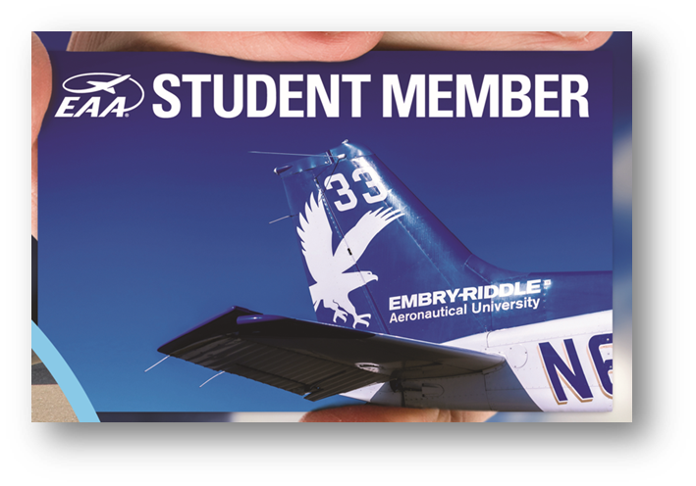
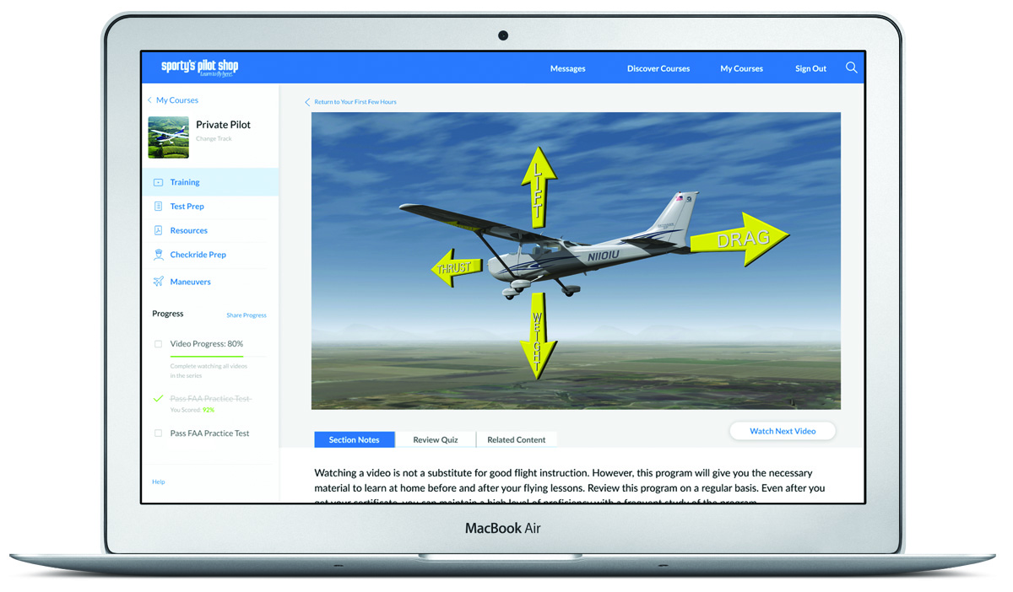
Young Eagles Flight Plan
Step 1 – Become a Young Eagle
Step 2 – EAA Student Membership
Step 3 – EAA AeroEducate
Step 4 – Sporty’s Learn to Fly Course ($299 value)
Step 5 – First Flight Lesson ($200 value)
Written Exam Reimbursement ($175 Value)
EAA Chapter #### Young Eagles
Notes:
Step 2: EAA Student Membership
Free of charge (Ages 8 – 18)
FREE Academy of Model Aeronautics Student Membership.
Electronic edition of Sport Aviation
All other EAA member benefits
FREE Access to nearlyy 400 museums
Access to scholarships and camperships
Join a local EAA Chapter
Access to all of EAA’s online videos
Step 3: EAA AeroEducate
Free resource for youth, parents, chapters, and teachers
Age based STEM activities
Pathways to industry careers
Pilots
Engineers
ATC
Management
Classroom, at home, and airport based activities
Earn badges
Backed by industry partners
Step 4: Sporty’s Learn to Fly Course
Free ground school (retails at $279)
Earn a free flight lesson
Prepares you for FAA knowledge exam – Receive endorsement
Multiple modules
HD videos
Review quizzes
Practice exams
Step 5: Free Flight Lesson and FAA Reimbursement
Upon completion of the first 3 modules in Sporty’s, EAA sends a paper waiver to the parent of the Young Eagle inviting their child to a free flight lesson
Parent signs and returns waiver to EAA, EAA informs Sporty’s of the completed waiver
Sporty’s then sends by email, a free first flight lesson voucher to the youth – up $130 value – take this to the local airport for reimbursement for a flight lesson
Upon completion of the entire Learn to Fly Course, the student is endorsed for the FAA Airman Knowledge test, and EAA emails the student instructions on how to get reimbursed for the cost of the test, for a value up to $175

Slide 13
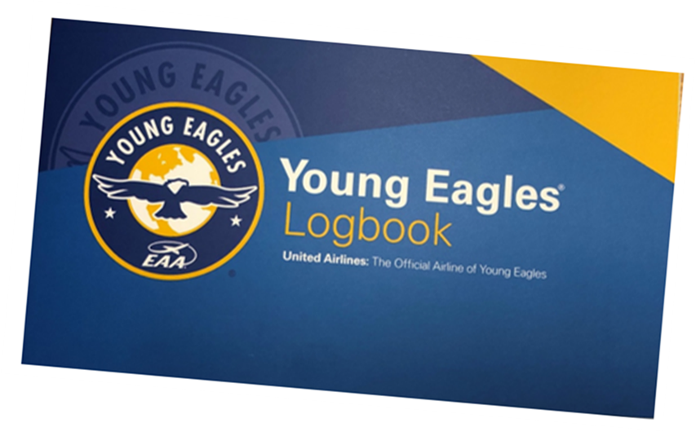
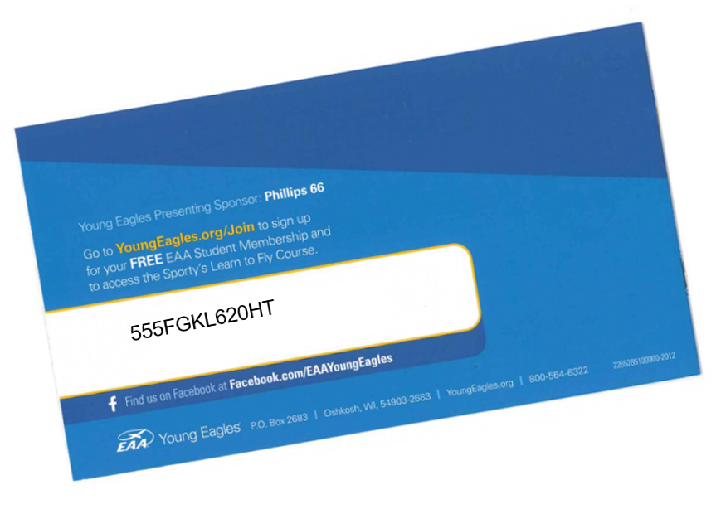
Young Eagles Flight Plan
Activating your benefits
Pre-registration – Checkbox on the form when you registered for today’s event.
Young Eagles Logbook – Code on the back. If in doubt, re-register using the instructions on the back of the logbook
EAA Chapter #### Young Eagles

Slide 14
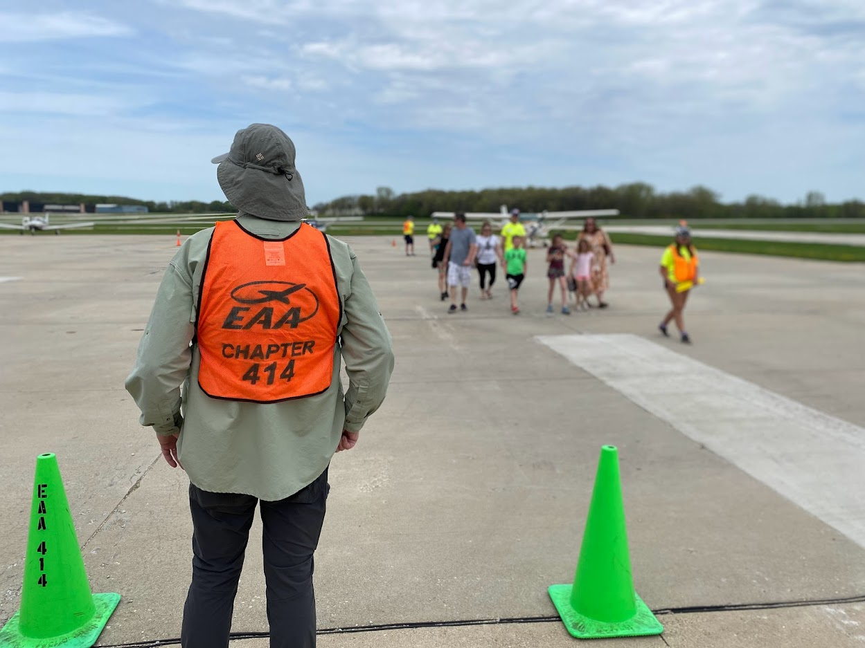
Ramp Safety
Stay with your pilot/ramp escort.
No horseplay
Parent(s) may accompany the Young Eagle to the plane, only with pilot/ramp escort. Photos are allowed and encouraged!
Once the Young Eagle has boarded, return to a safe area with the ramp escort.
Do not enter the ramp without an escort.
Keep your head on a swivel – Watch for blinking/flashing lights, spinning propellers, and moving aircraft
Listen to all volunteer instructions
EAA Chapter #### Young Eagles

Slide 15
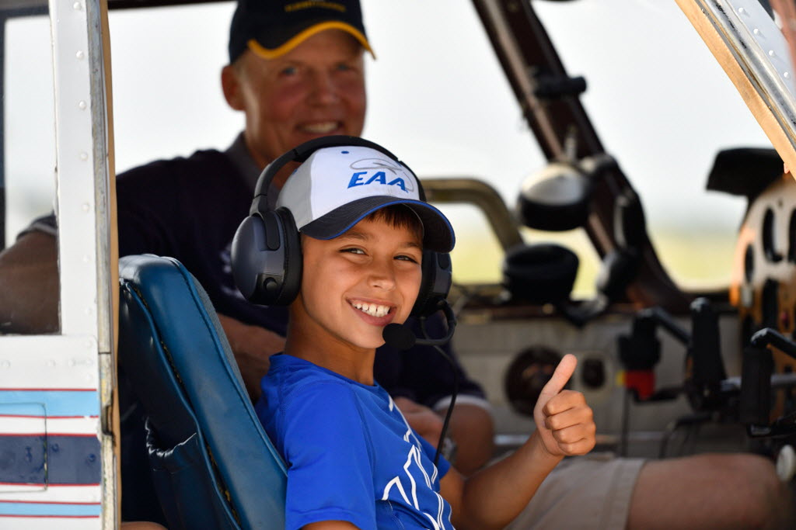
Safety in the Aircraft
Listen to your pilot.
Be careful not to pull on controls, push buttons, or flip switches.
Keep your seatbelt on.
Try not to ask questions until the pilot says it is ok to do so.
Have fun!!
EAA Chapter #### Young Eagles

Slide 16
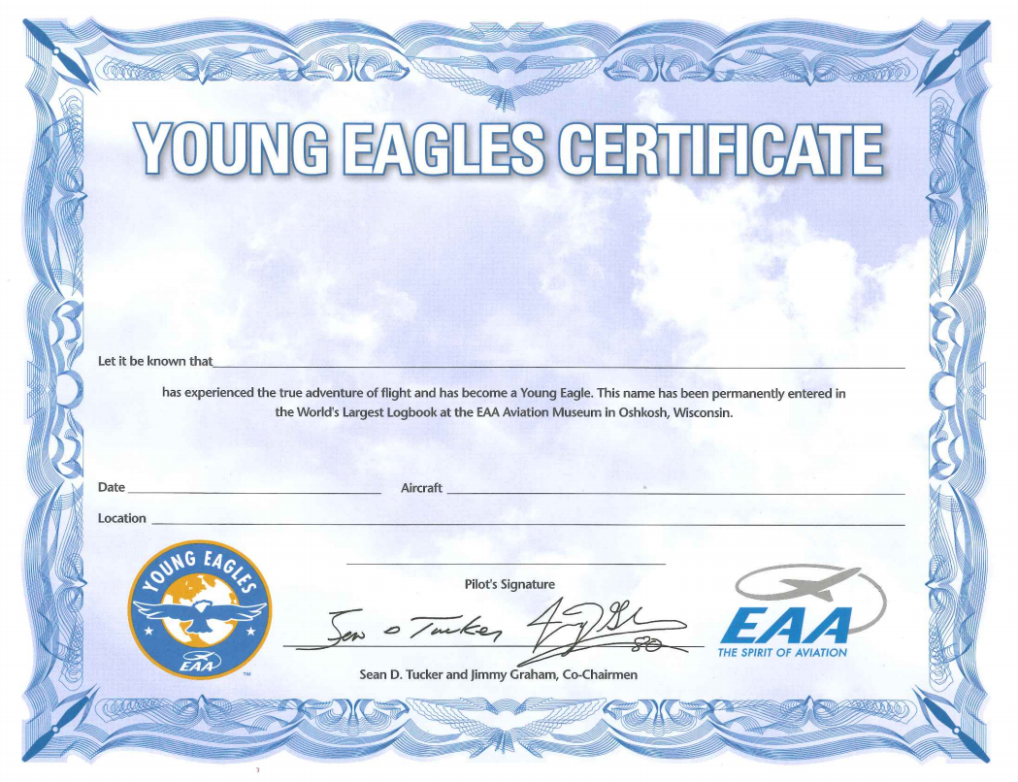
After the Flight
Stay with your pilot until you are back in a safe area/off the ramp.
Be sure to get your Young Eagles Logbook and Certificate
Ask questions!
Activate the Young Eagles Flight Plan
EAA Chapter #### Young Eagles

Slide 17
About EAA Chapter ####
Regular Monthly Gatherings
Second Tuesday of each month at 6:30 pm
Chapter Hangar
Other youth activities
Young Eagles Build and Fly
Young Eagles Workshops
Adult activities
Flying Start – Adult Eagle Flights
Contact Information
Web: EAA###.org
Phone: 123-456-7890
Email: EAA###@gmail.com
Thank you for attending!!
EAA Chapter #### Young Eagles

